Slide 1
Investigating Celebrity Endorsements:
A Data-Driven Exploration
Jinhang Jiang, Bhavana Patil, Dhruv Tyagi, Jinghuan Li
Guided by: Dr. Victor Benjamin
Notes:
https://employees.wpcarey.asu.edu/resources/marketing-and-communications/templates

Slide 2
Agenda
Business Motivation
Model Design -
Decision Support System(DSS)
Case study 1
Case study 2
Exploring Instagram
Summary
Notes:
So, for a temporary title of our presentation, it could be “Decision Support System for Adidas Endorsement “ or something similar. And the data is mainly from Reddit, including text data(comments) and user interaction data. We also explore the Instagram for image data. And the techniques we used are social network analysis, similarity analysis(based on recommender system), and text analytics(word2vec). We can the output from our DSS is matching up Adidas internal human analysis, it would be a good help. And we also did a case study assuming if they want to expand market in Korea. For the additions, I wrote many scripts from collecting data to modeling, they can develop a more mature DSS based on the codes.

Slide 3
Business Motivation
Influencer marketing is increasingly important
Adidas pursues this strategy with great success (e.g., Kanye west)
But, so far the effort is largely ad-hoc or relies on much manual effort
Current approaches fails to consider unstructured data in social media (text, image, video)
Thus, a decision support system would be a great asset

Slide 4
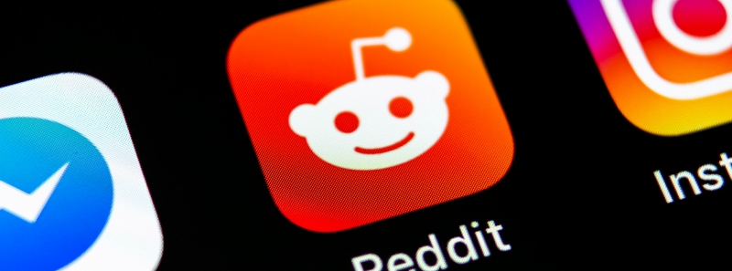
What we started with?
A social news aggregation, web content rating, and discussion website
www.reddit.com

Slide 5
Why Reddit？
Reddit has over 430 million monthly active users. An increase of 30.3% from a year earlier.
52 million daily active users access Reddit.
25% of US adults use Reddit.
In 2020, Reddit was ranked the 7th most popular social media app in the US.
303.4 million posts were shared on Reddit in 2020, a 52.4% year-over-year growth.
2 billion comments were shared on Reddit in 2020.
It also allows for analysis of long-form social media instead of just short messages (twitter)
Source:https://backlinko.com/reddit-users

Slide 6
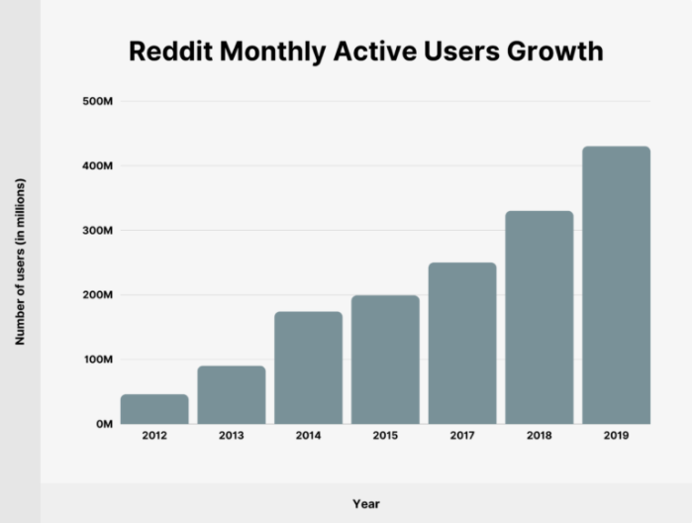
Reddit
From 2015 to 2019, the number of Reddit monthly active users has grown by 258.33%. And it continues to grow in 2020 and 2021 ...
Source:https://backlinko.com/reddit-users

Slide 7
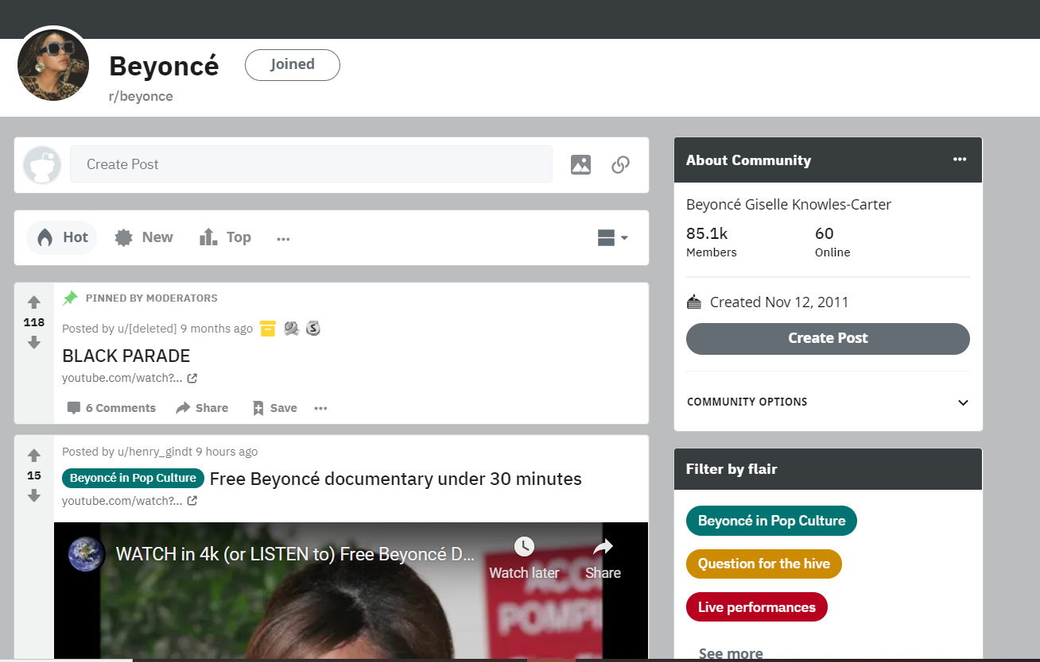
What is a subreddit?
Subreddit name
Information on the Subreddit
Information on the post

Slide 8
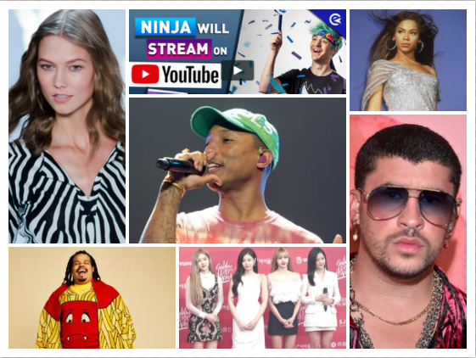
The influencers we started with:
Mr. Brooks Clemens gave us a list of influencers who are sponsored by Adidas.
Given the fact that not every influencer is being mentioned regularly on Reddit, we picked 14 of them through research to avoid underfitting.
List of influencers:
Adriene Mishler
Ally Love
Bad Bunny
Beyonce
BlackPink
Chinae Alexander
Jerry Lorenzo
Karlie Kloss
Kerwin Frost
Naeun Son
Ninjas Hyper
Pharrell Williams
Yara Shahidi
Zoe Saldana

Slide 9
About the Data
Types of data collected : user information, text data, image data
Total posts collected :35000+, which are summed to 22M words
Unique users : 8384
Data was collected from their respective subreddit and based on keyword search.
Influencer | MsgID | Timestamp | Author | ThreadID | ThreadTitle | MsgBody | ReplyTo
NinjasHyper | ‘gnqnhbb’ | ‘2021-02-17’ | ‘KidCaker’ | ‘co3y25’ | ‘Stunning!...’ | ‘Epic! He…’ | ‘gnkvpte’
... | ... | ... | ... | ... | ... | ... | ...

Slide 10
Collected Data
Data is grouped into three versions for testing and case study:
Version 1: 14 Celebrities is sponsored by Adidas
Version 2: Two adidas sponsored Korean celebrities + another eight picked Korean celebrities (based on stage style and popularity)
Version 3: Combined of version 1&2, aiming to improve the performance of the model

Slide 11
How do we bring the machine learning into the business decisions?

Slide 12
Model Design and Training
Text Mining
Word2vec, TF-IDF, and many others...
Social Network Analysis (SNA)
Basic decision modeling, node2vec
Image Analysis
Google NIMA

Slide 13
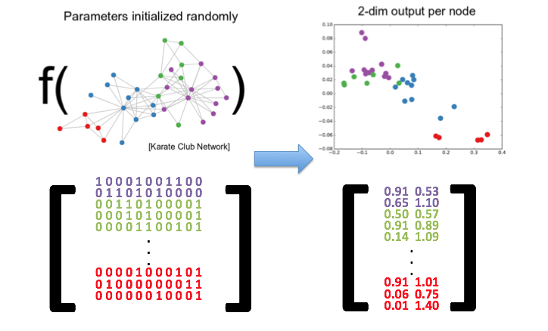
Embedding
In the context of machine learning, an embedding is a low-dimensional, learned continuous vector representation of discrete variables into which you can translate high-dimensional vectors. Generally, embeddings make ML models more efficient and easier to work with, and can be used with other models as well.
(Source:https://datascience.stackexchange.com/questions/53995/what-does-embedding-mean-in-machine-learning)

Slide 14
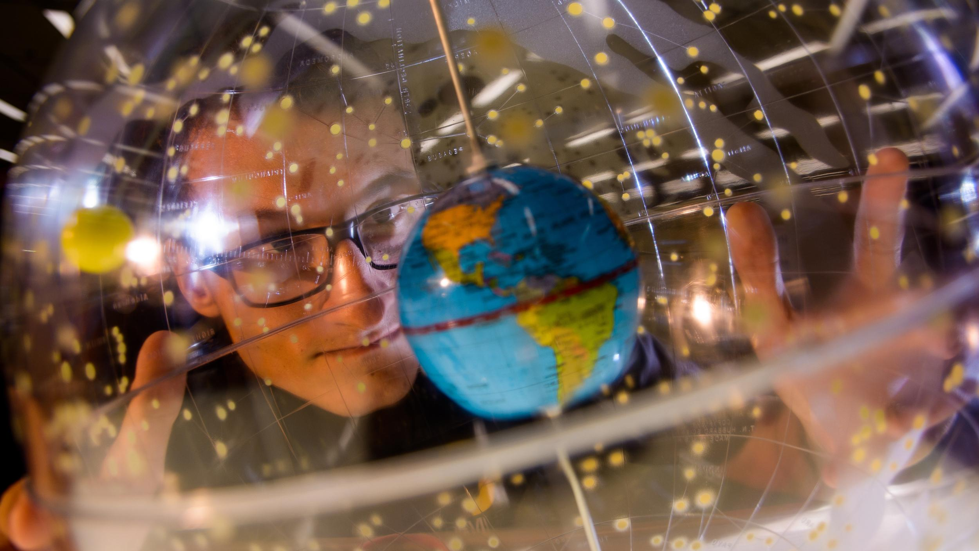
Text Analytics
01
TF-IDF
Term frequency–inverse document frequency
Reflects importance of a word to a document
02
Word2vec + TF-IDF
Word embeddings
Vectors of numeric representations of words
Self-trained model
03
GloVe + TF-IDF
Word embeddings
Pre-trained model
1M+ words
04
BERT
Sentence embeddings
State of the art model
10+ pre-trained models from billions of words
05
Sent2vec
Sentence embeddings
Good on small dataset (pre-trained models)
Crashed with large dataset due to RAM limits
06
Doc2vec
Document embeddings
Vectors of numeric representations of docs
Self-trained model

Slide 15
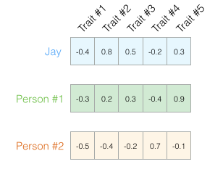
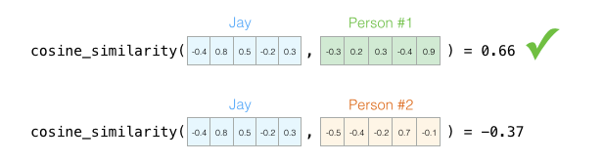
Word2vec
Source: https://jalammar.github.io/illustrated-word2vec/

Slide 16
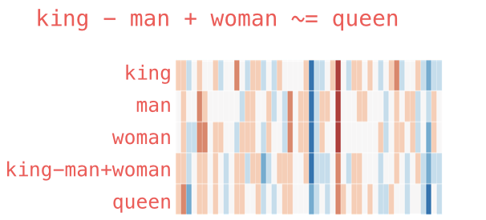
Word2vec
The resulting vector from "king-man+woman" doesn't exactly equal "queen", but "queen" is the closest word to it from the 400,000 word embeddings we have in this collection.

Slide 17
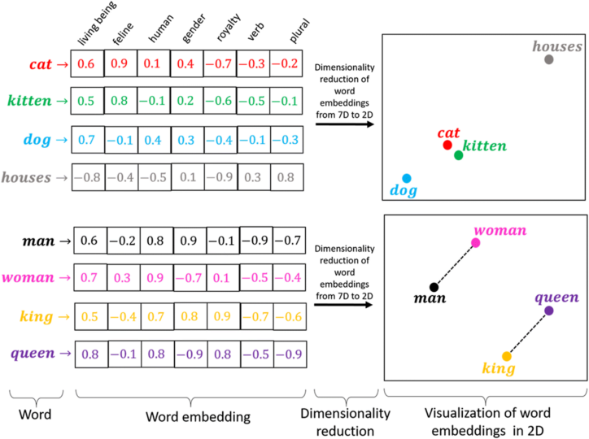
Word2vec
It did twice dimension reduction during the process:
a corpus of words → a list of unique words with vector representations
vectors → 2D embeddings

Slide 18
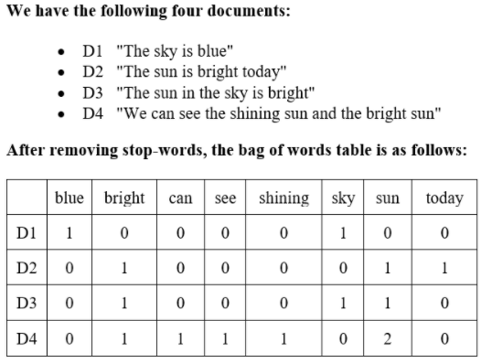
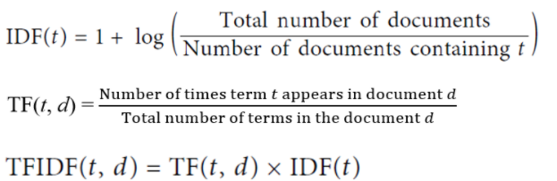
TF-IDF
TF-IDF, short for term frequency–inverse document frequency, is a numerical statistic that is intended to reflect how important a word is to a document in a collection or corpus.

Slide 19
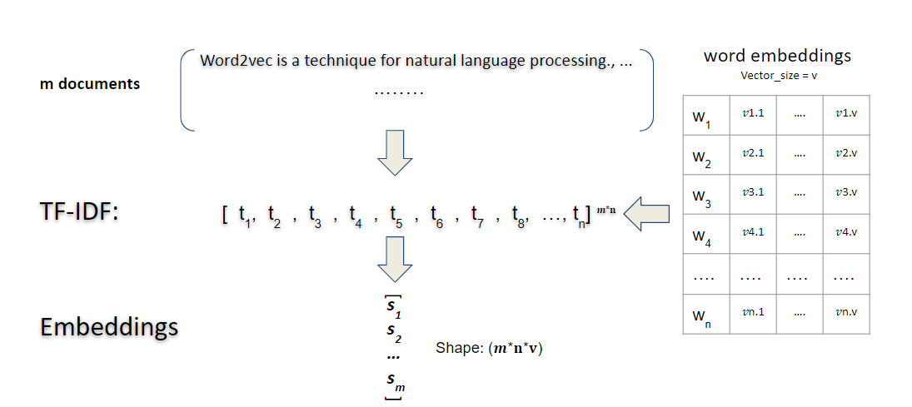
How the modeling works

Slide 20
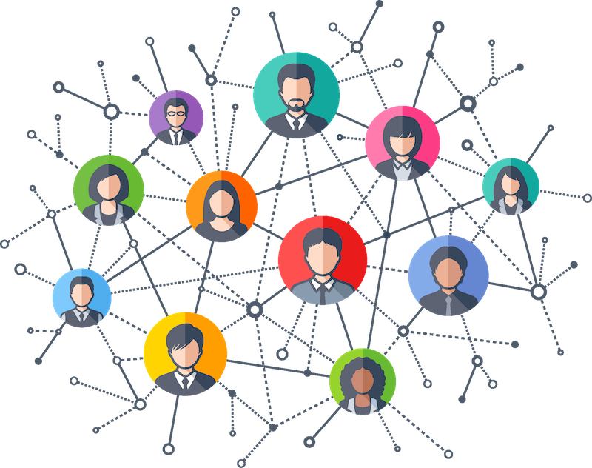
Social Network Analysis (SNA)
Social network analysis is the process of investigating social structures through the use of networks and graph theory.
It characterizes networked structures in terms of nodes and the ties, edges, or links that connect them.

Slide 21
Basic Decision Modeling
Implementation of term-document matrix in social network analysis
Find the number of occurrences of each users for each influencer
Compute the cosine similarity between the vectors of occurrences
Sorting the results and find the closest ones

Slide 22
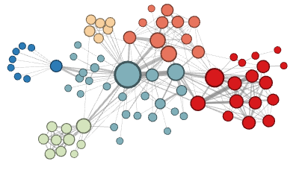
SNA with node2vec
Node2vec is an algorithm to generate vector representations of nodes on a graph, which is built upon the idea of word2vec.
Primary function is to convert high dimensional data/information into a low-dimensional representations.

Slide 23
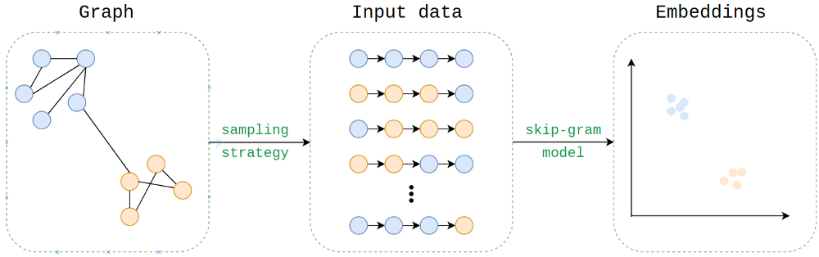
SNA with node2vec

Slide 24
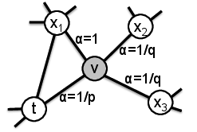
SNA with node2vec
It provides a way of balancing the exploration-exploitation tradeoff that in turn leads to representations obeying a spectrum of equivalences from homophily to structural equivalence.
After transitioning to node v from t, the return hyperparameter, p and the in-out hyperparameter, q control the probability of a walk staying inward revisiting nodes (t), staying close to the preceding nodes (x1), or moving outward farther away (x2, x3).
If p>q, the likelihood of going back to node (t) is diminishing;
If q>p, it will more likely revisit node (t).

Slide 25
SNA with node2vec
Analyzing
Data
Social Network Analysis
(SNA)
w. node2vec
Use Embeddings
Draw Graph
EB
NX
Generate Embeddings

Slide 26
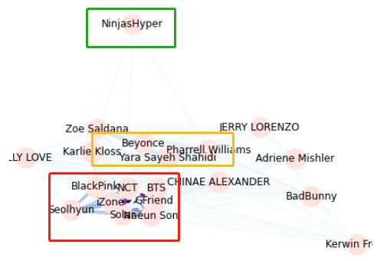
SNA with node2vec
Data for SNA
Celebrity (Nodes) | Usernames (Edges)
Beyonce | User01
…. | ….
Graph
Emberdding
T-SNE Plot Node2vec Built-in Feature K-means Clustering
Usages
Nodes | Embeddings
Beyonce | -0.1315, 0.7745, ...
…. | ….
Naeun Son | 0.8516, 0.1442, ...

Slide 27
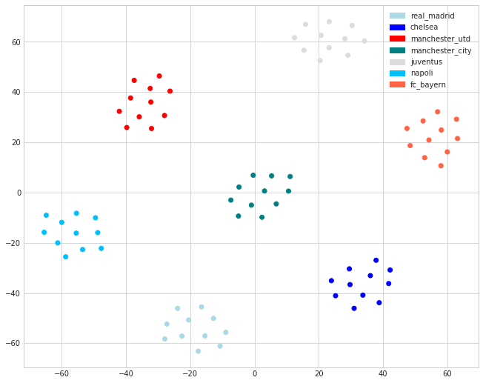
SNA with node2vec
Usage 1: T-SNE Plot
Usage 2: node2vec built-in feature
model.wv.most_similar("Celebrity 12",topn=5)
[('Celebrity 1', 0.9880407452583313),
('Celebrity 8', 0.9570997071266174),
('Celebrity 4', 0.9056358766555786),
('Celebrity 6', 0.8254547381401062),
('Celebrity 5', 0.7046592545509338)]
Usage 3: K-means Clusterings
Group 1
0 ... n
Celebrity 1 -0.019673 ... 0.085747
Celebrity 3 -0.011764 ... 0.091183
[2 rows x n columns]
....
Group k
0 ... n
Celebrity 4 0.022665 ... 0.011859
Celebrity 5 0.018963 ... 0.010145
[2 rows x n columns]

Slide 28





Data is Biased on Reddit
Different backgrounds
Not all of them on reddit
22% of users aged from 18 to 29 (as of February 2019)

Slide 29
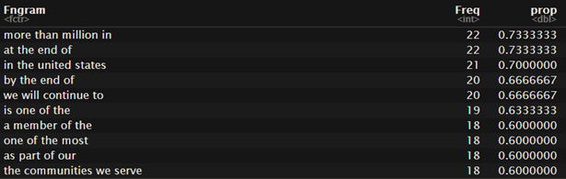
Potential Future Work of Text Mining
Compute boilerplate to increase the informativeness and uniqueness of the “documents” for each celebrity.
*In textual analysis, Boilerplate is a combination of words that can be removed from a sentence without significantly changing the original meaning

Slide 30
Potential Future Work of Text Mining
Find the 4-grams appear across documents
Mark the sentence with those 4-grams as 0, otherwise as 1
Step 1
Step 3
Step 2
Step 4
Sort the 4-grams by frequency, and keep the ones that have appeared in more than 30% of documents
Add the vectors of boilerplate to the calculations of Word2vec+TFIDF

Slide 31
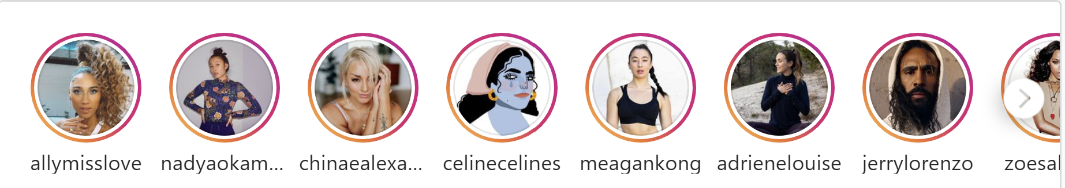
Possibilities on Analyzing Instagram Stories

Slide 32
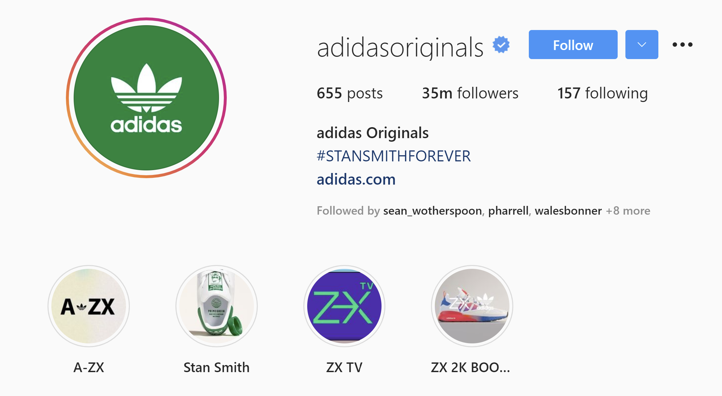
What are instagram Stories?
"Share all the moments of your day, not just the ones you want to keep on your profile"
Ephemeral: expires 24 hours after posting
Can be permanent if user add it as a highlight
Story
Highlights

Slide 33
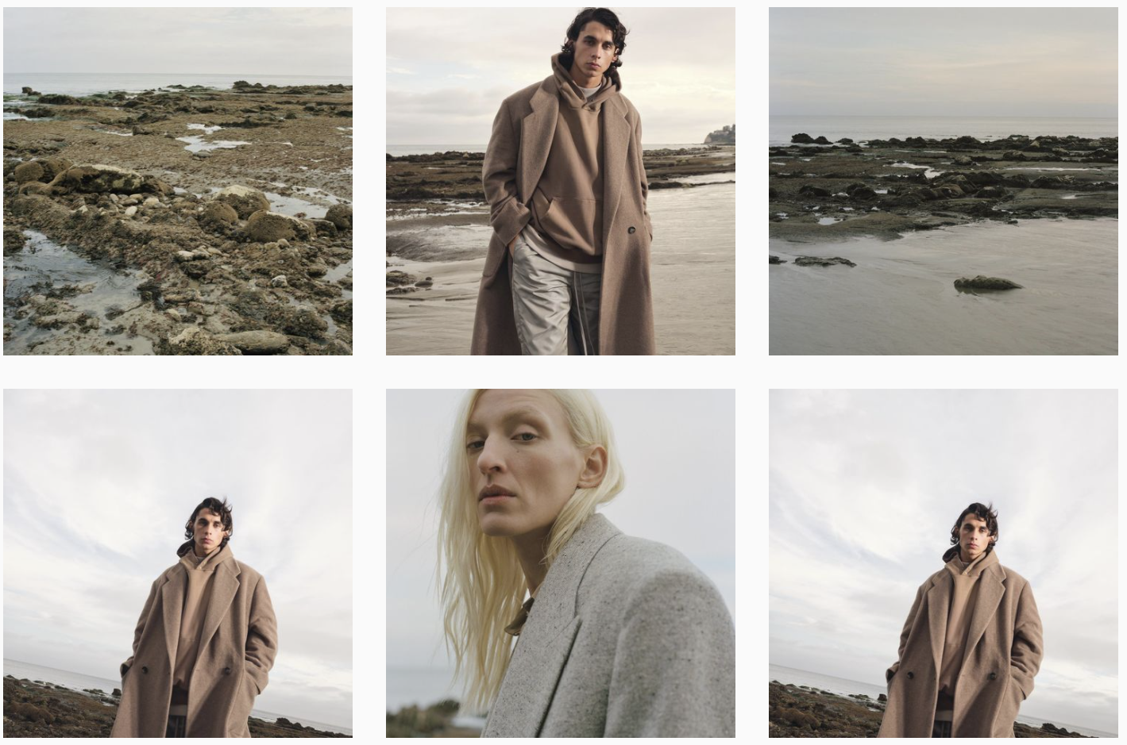
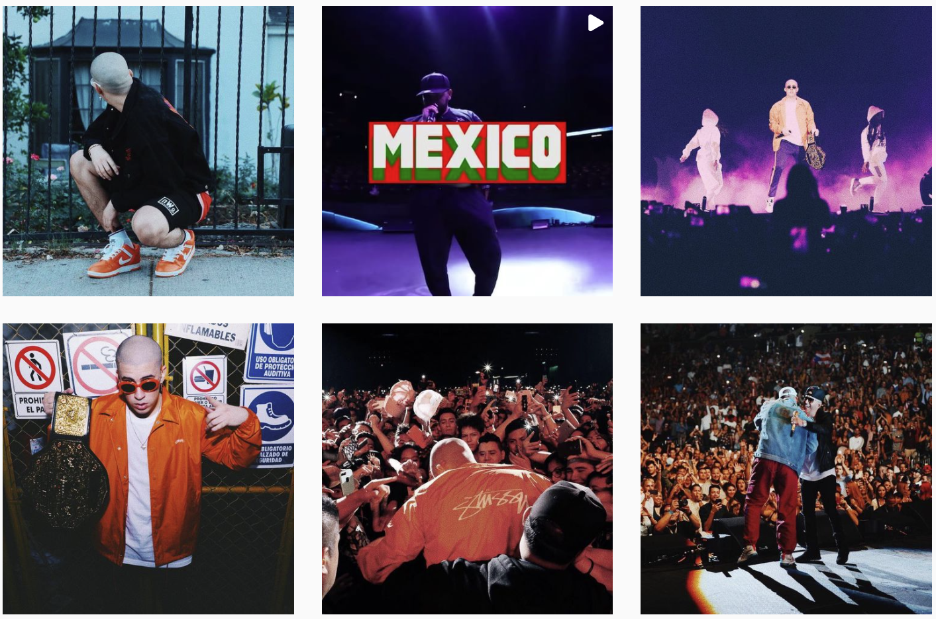
Business Value
Understand celebrities’ different aesthetic styles (visual feeling)
Avoid style overlap when marketing products
Tailor product endorsement matchup with celebrities’ show style
Jerry Lorenzo
Bad Bunny

Slide 34
Problems to Solve
Computationally assessing image quality of Stories
Getting Instagram Stories
Detecting images with Adidas logos
Scoring images
1
Clustering images by style
2

Slide 35
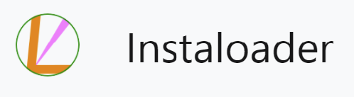
Getting Instagram Stories
Open source API - Instaloader:
Python Module, Ready to use
Full capability of downloading media along with its metadata
Local output:
Media (jpg for image, mp4 and jpg thumbnail for videos)
Metadata (zipped json file)
https://instaloader.github.io/index.html
https://instaloader.github.io/as-module.html#module-instaloader

Slide 36
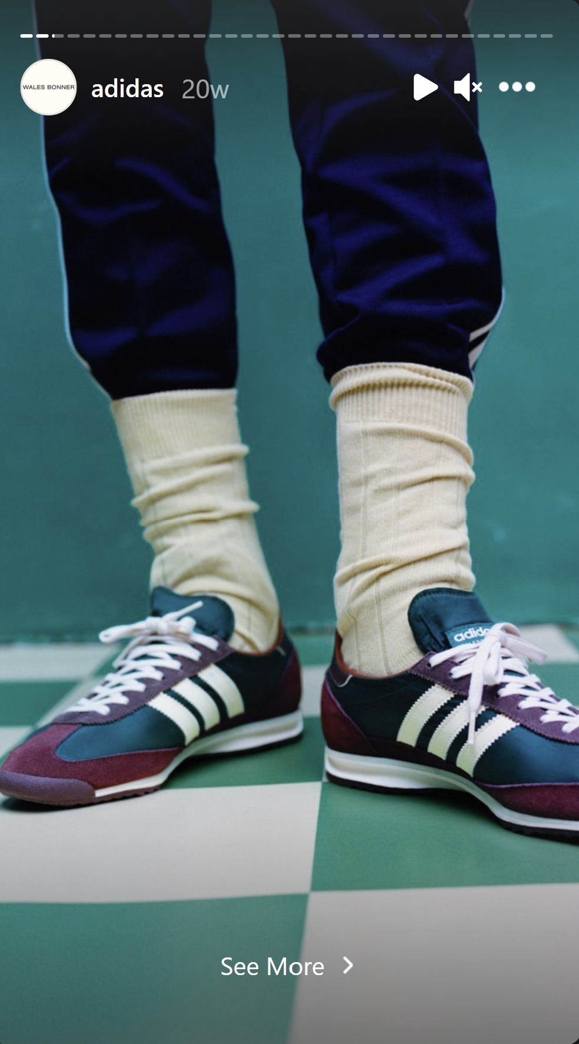
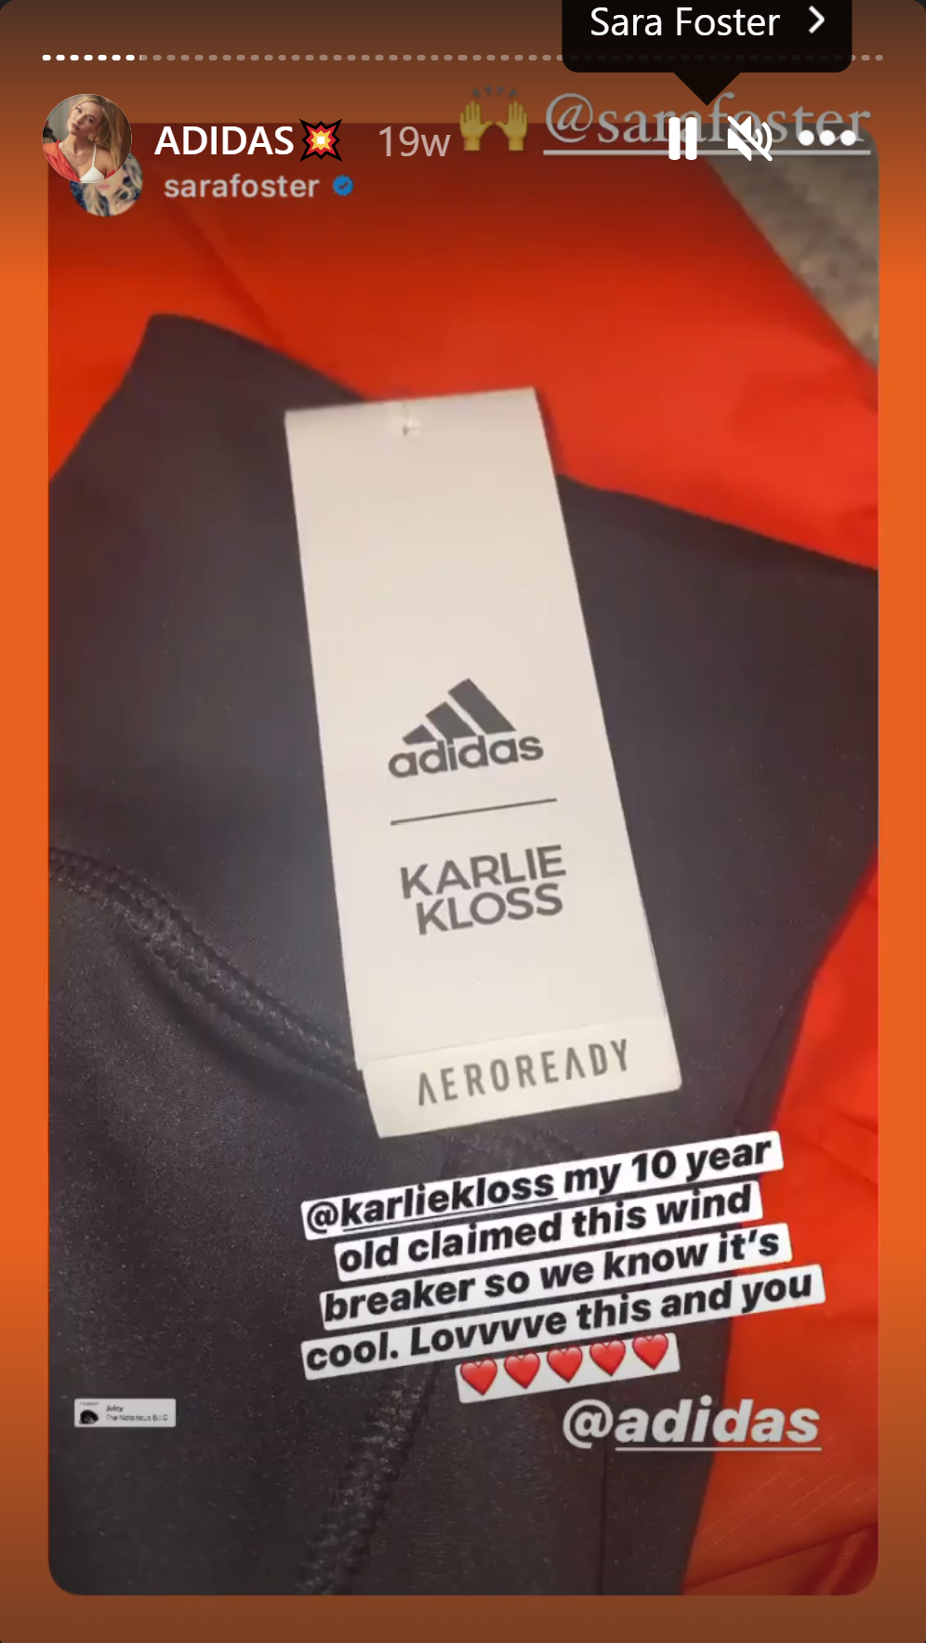
Analyzing photos with Google NIMA
Google NIMA:
A Neural Image Assessment model
Image quality:
technical / aesthetic scores
technical scores 5.3163 4.3772
aesthetic scores 5.4846 4.3204

Slide 37
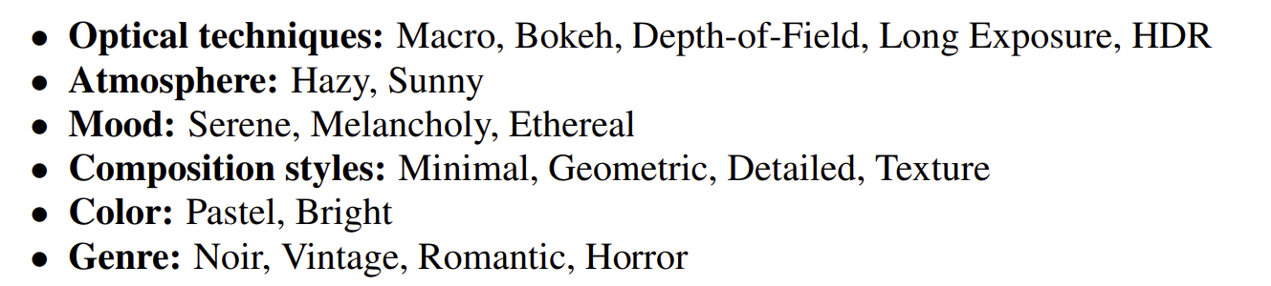
Clustering Stories by Style
Vislab by Sergey Karayev - a set of Python modules for visual recognition
features: based on color dependency, composition, visual attention…
architecture: Caffe Deep convolutional Framework
dataset: 80K flickr images with 20 style labels
capability of crossing platforms: train from flicker and test on Pinterest

Slide 38
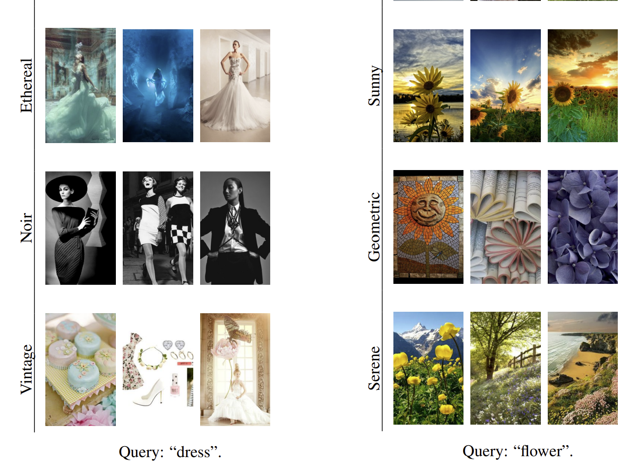
Clustering Stories by Style
Combine style classification with the query of each celebrity to explore the dominant visual style

Slide 39
Limitations on Getting Instagram Stories
Need to create an instagram account and follow all target users
No way to catch expired stories
need to run the script on 24-hour intervals to get all stories
429 Too Many Requests
sometimes throw this error at around 200 fetches
multiple accounts to scrape the data

